Slide 1

Fraud Detection

Slide 2






Fraud Detection
FRAUD = DECEPTION
ILLEGAL & CRIMINAL OFFENSE.
DETECTING FRAUD AND AVOIDING IT
DATA MINING FOR FRAUD DETECTION
FIND ANOMALIES IN DATA I.E. THE OUTLIERS
AN OUTLIER = OBSERVATION THAT IS SUSPICIOUS
Today we’ll overlooking at the sales data from a unknown company to find suspicious transactions and setup a fraud detection technique

Slide 3
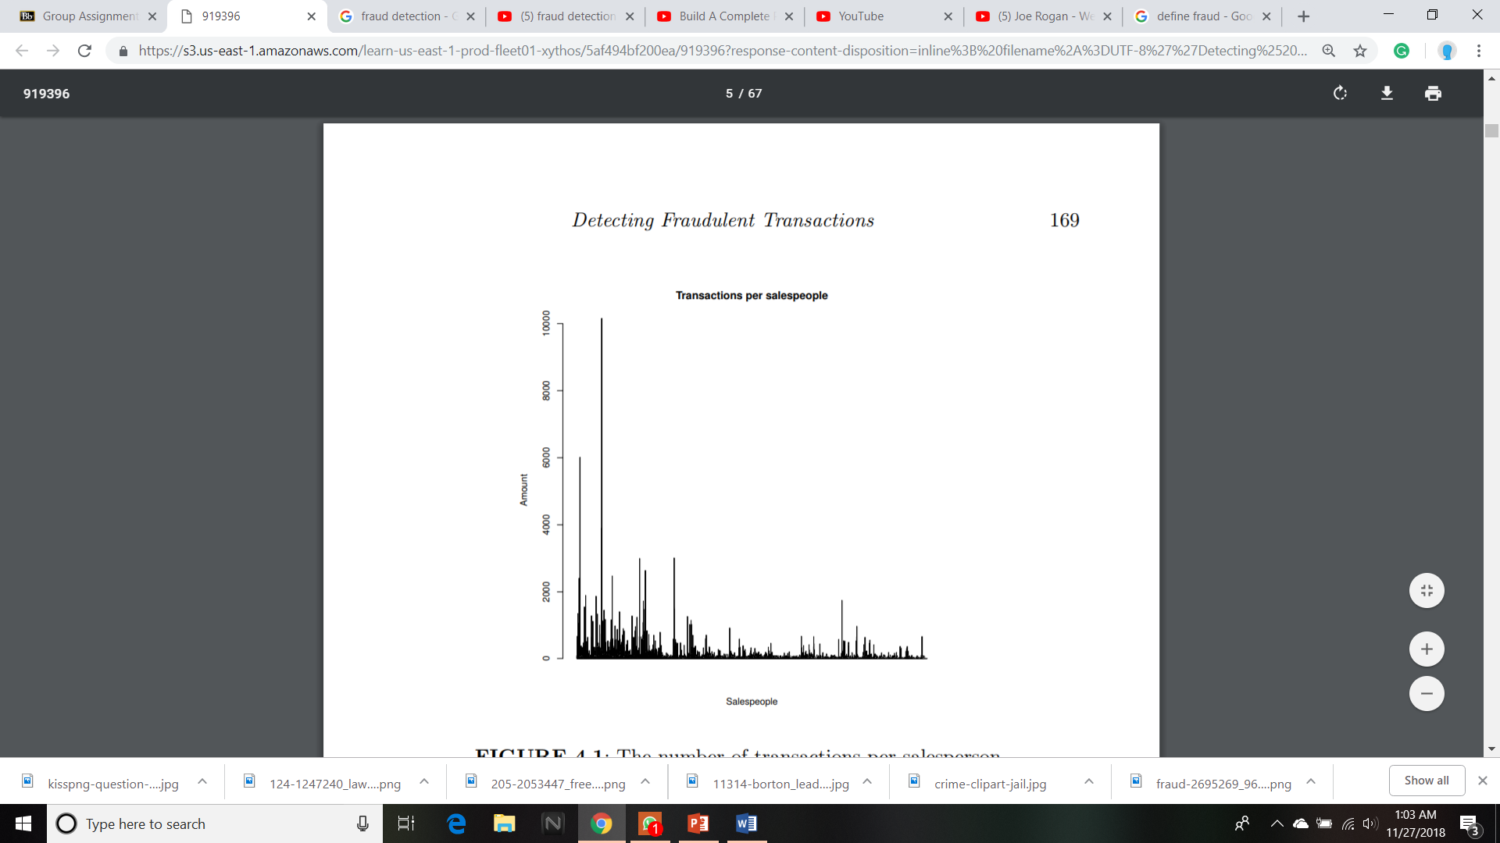
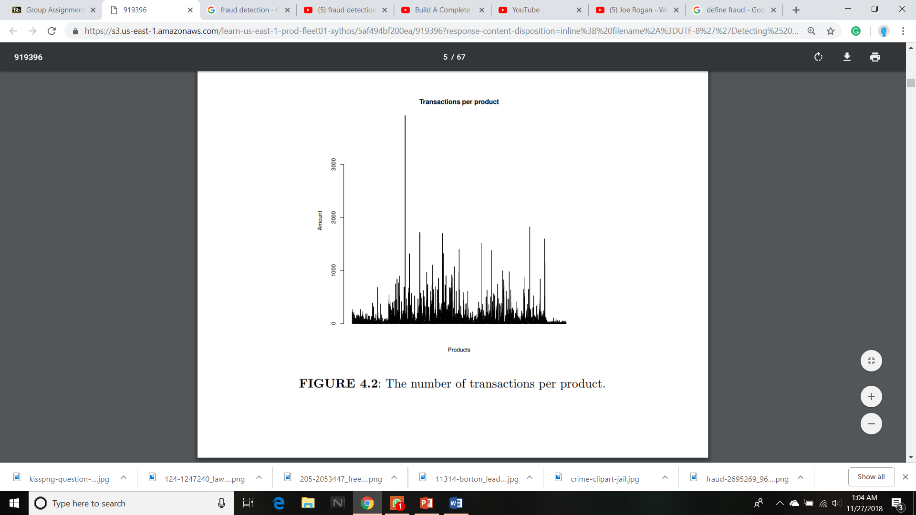
DATA
PRE-ANALYZED SALES DATA
ATTRIBUTES FOR ID SALES ETC
SPECIAL PRECOMPUTED COLUMN
High VARIABILTY
Similar Products Different Quantities
Analyze unit price of each product
Products with less transactions
MEDIAN PRICE TO REPRESENT THE PRICE

Slide 4
Problems in Data
DEALING WITH UNKNOWN VALUES
either REMOVE or FILL UNKNOWN
If opting to remove, check if they belong to same salesperson
If opting to fill unknown, fill with information from similar complete transactions
FEW TRANSACTIONS OF SOME PRODUCTS
Check if any of them is unusual
Infer some similarities between distributions of unit prices
Merge product with similar prices to analyze them
Even though the data base has the added column of INSPECTION in it, most of the reports have not been inspected and are labeled as UNK.
To overcome this we will use different modeling approaches which are discussed next.

Slide 5
Types of Observation
Outlier Detection
Description + Unknown
Description + Results
Clustering
INPUT + OUTPUT + ALGORITHM
Discovering the inherent groupings in the data
Finding data that deviate from the expectations
In our case, we are dealing with the classification problem having particularity.
Also it suffers from establishing a ranking of the transactions classified as fraud.
So we resort to probabilistic classification…
Unsupervised learning
Supervised learning

Slide 6
another type of data observation..
Semi-Supervised Observation
It runs on both type of observations..
Blend of supervised and unsupervised
Semi-Supervised Methods
Improve by adding unlabeled classes
Clustering using labeled classes
also there is a method of self training…
and another approach i.e. Transductive Support Vector Machines...

Slide 7
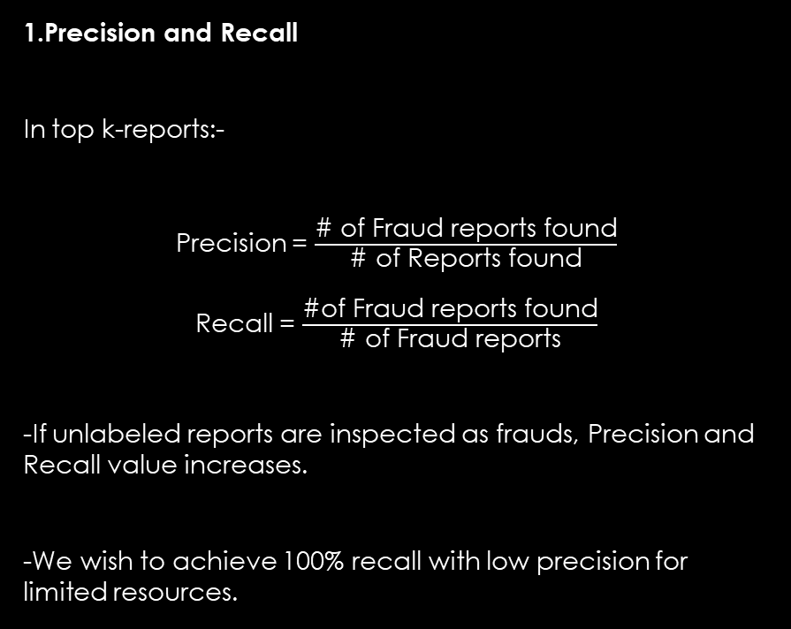
Evaluation Criteria :
Supervised Classification Evaluation
1.Precision and Recall
In top k-reports:-
Precision = $\frac{\text{\# }\text{of} \text{Fraud} \text{reports} \text{found}}{\text{\# }\text{of} \text{Reports} \text{found}}$
Recall = $\frac{\text{\#}\text{of} \text{Fraud} \text{reports} \text{found}}{\text{\# }\text{of} \text{Fraud} \text{reports}}$
-If unlabeled reports are inspected as frauds, Precision and Recall value increases.
-We wish to achieve 100% recall with low precision for limited resources.
2.Lift Charts and Precision/Recall Curves
-PR Curves are visual representations of the performance of a model in terms of precision and recall statistics.
-We iterate over different effort limits to get different values of precision and recall.
-We do post-processing of the outlier rankings to obtain their PR score and respective PR curves.
-Lift charts of the model prediction gives more importance to the values of recall.
-Lift charts can be obtained with the infrastructure provided by the ROCR package.

Slide 8
Evaluation Criteria:
Unsupervised Classification Evaluation
Normalized Distance to Typical Price
-Used to check for unlabeled cases correctly positioned in the ranking.
-The smaller the distance between unit price of a report and typical unit price of the respective product, the better the quality outlier ranking obtained by a model.
-To get a uniform scale, we normalize the distance to the typical unit price using IQR.
Experimental Methodology
-It is used to obtain reliable estimates of the selected evaluation metrics.
-Hold-Out method of experimental comparisons: randomly splitting the available dataset in two partitions
(typically in 70%/30% proportions)
-Used to handle imbalanced class distributions through stratified sampling strategy.
-Implemented in R using holdOut() function.

Slide 9
Obtaining Outlier Rankings
We will use different approaches to obtain and then compare the outlier rankings
UNSUPERVISED APPROACH
The Modified Box Plot Rule
The modified box-and-whisker plot will plot outliers as individual points beyond the whisker to give a more accurate picture of the dispersion of the data.
Here, we are using normalized distance to the typical (median) unit price (NDTP) to decide on the “outlyingness” of a value. NDTP being unitless metric can be used for different products.
Local Outlier Factors (LOF)
The main idea of this system is to obtain an outlyingness score for each case by estimating its degree of isolation with respect to its local neighborhood.
Regions with very low density are considered outliers.
Clustering-Based Outlier Rankings (ORh)
It uses Hierarchical agglomerative clustering algorithm to obtain a dendrogram of the given data.
It’s an iterative process of merging the similar observations together in a cluster until the last two groups are merged into a single cluster with all observations.

Slide 10
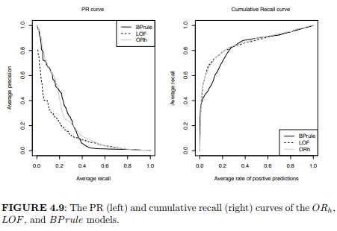
Comparison
BPrule
LOF
Orh
PR Curve Result
Smaller values compared to both
Higher than LOF and slight better than BPrule
Higher than LOF
Cumulative Recall Curve Result
Slight variation from both
Similar to LOF and slight different from Bprule
Similar to LOF and slight different from Bprule

Slide 11
Obtaining Outlier Rankings
Supervised Approaches
We are using manipulated training dataset to negate the class imbalance effect.
Naive Bayes
It is a probabilistic classifier based on the Bayes theorem
SMOTE algorithm is used to create the training set
AdaBoost
It is a learning algorithm that belongs to the class of ensemble models
- In our case we are using AdaBoost.M1 from Rweka.

Slide 12
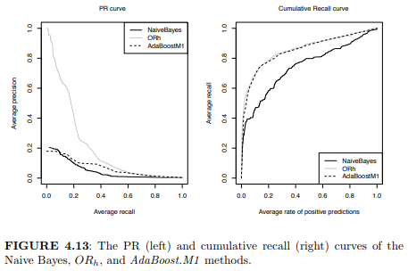
Comparison
Naïve Bayes
Adaboost1
Orh
PR Curve Result
Very poor results
Very Poor results
Better than both
Cumulative Recall Curve Result
Less score than both
Similar results to ORh
Similar results to Adaboost1

Slide 13
Obtaining Outlier Rankings
Semi-Supervised Approach
This approach firstly builds a classifier to predict the unlabeled data. And then the classifiers with the higher confidence are used as training.
In our case we used both Self-Trained Naïve Bayes and AdaBoost models but could not achieve the better results than ORh model in terms of Precision Recall where as in Cumulative recall, Self Trained AdaBoost1 model had slight domination over other models.

